Slide 1

CIBE
GENERAL ASSEMBLY
26-27. 05. 2011.
HUNGARY

Slide 2
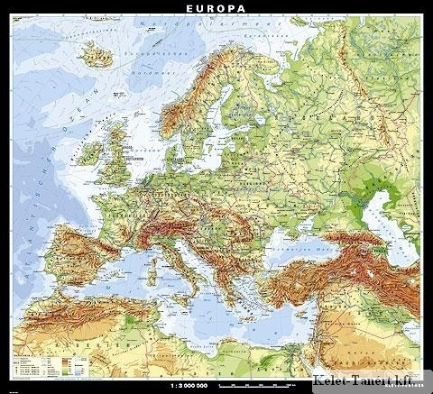
CIBE GENERAL ASSEMBLY
26-27.05.2011.
HUNGARY
INVITATION
EINLADUNG
ZAPROSZENIE
INVITO
INVITACIÓN

Slide 3
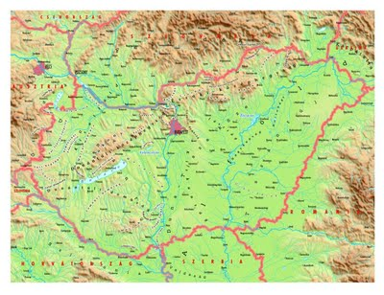
CIBE GENERAL ASSEMBLY
THE CONFEDERATION OF HUNGARIAN SUGAR BEET GROWERS WITH RESPECT AND AFFECTION INVITE THE MEMBERS OF THE CIBE TO HUNGARY. THE NEXT GENERAL ASSEMBLY WILL BE HELD ON
26-27. MAY 2011 IN BUDAPEST.

Slide 4
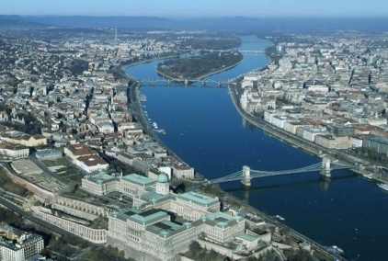
CIBE GENERAL ASSEMBLY
WE WELCOME YOU!
NOUS VOUS SOUHAITONS LA BIENVENUE!
WIR BEGRÜSSEN SIE!
SERDECZNIE ZAPRASZAMY!
VI DIAMO IL BENVENUTO!
LE DAMOS LA BIENVENIDA!

Slide 5
CIBE GENERAL ASSEMBLY
Budapest
26. May 2011

Slide 6

CIBE GENERAL ASSEMBLY
26. MAY 2011

Slide 7
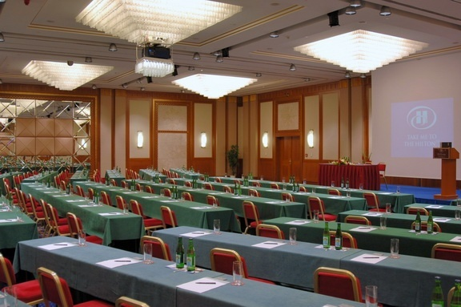
CIBE GENERAL ASSEMBLY
26. MAY 2011
MEETING

Slide 8
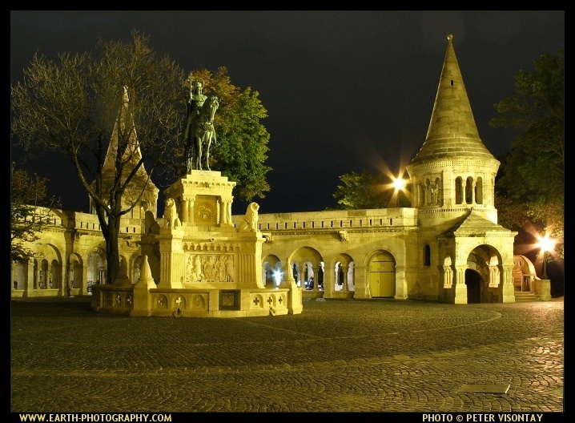
CIBE GENERAL ASSEMBLY
26. MAY 2011
GALA DINNER
HOTEL HILTON PANORAMIC ROOM

Slide 9
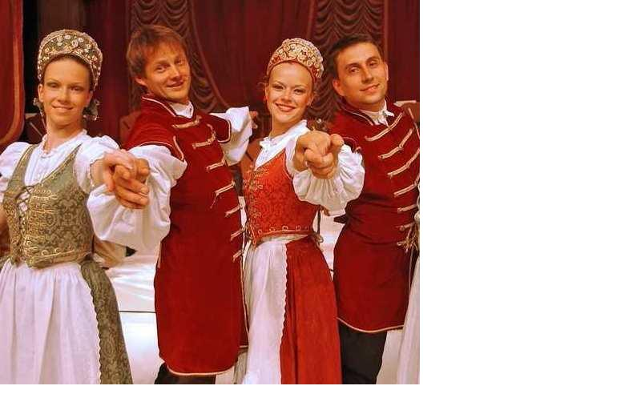
CIBE GENERAL ASSEMBLY
FOLKLORE SHOW

Slide 10
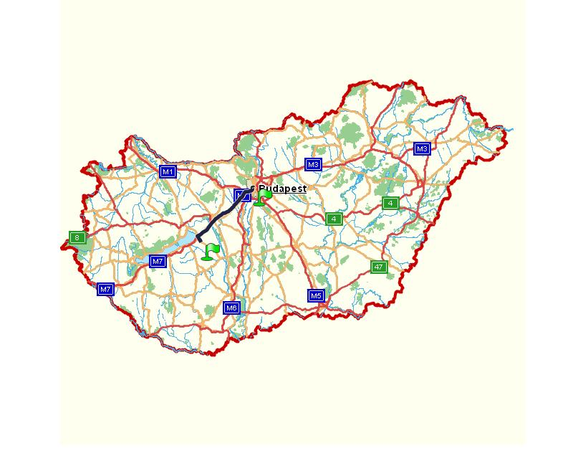
CIBE GENERAL ASSEMBLY
26. MAY 2011 BUDAPEST
27. MAY 2011 ENYING

Slide 11
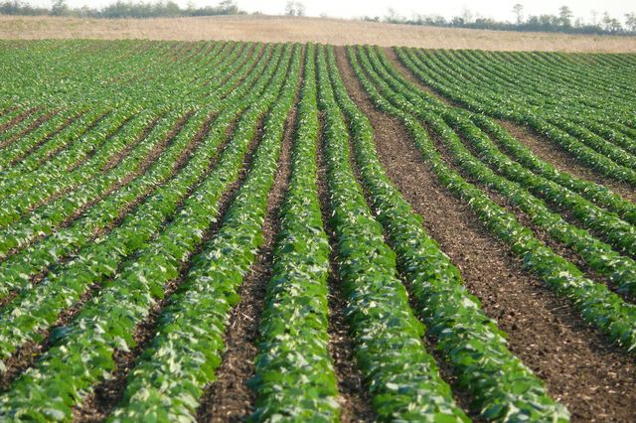
CIBE GENERAL ASSEMBLY
27. MAY 2011
TECHNICAL VISIT
ENYING-AGRÁR ZRT.

Slide 12
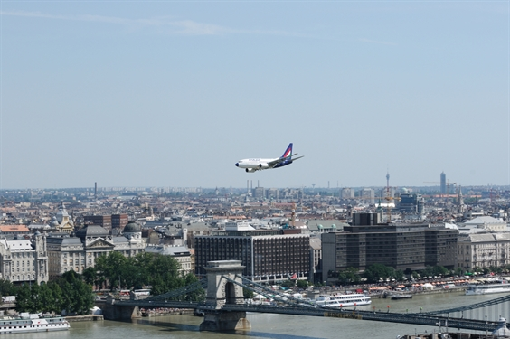
CIBE GENERAL ASSEMBLY
GOODBYE IN BUDAPEST
AU REVOIR A BUDAPEST
AUF WIEDERSEHN IN
BUDAPEST
DO WIDZENIA BUDAPESZT
ARRIVEDERCI BUDAPEST
BUENO BYE BUDAPEST

Slide 13

CIBE GENERAL ASSEMBLY
ON BEHALF OF THE HUNGARIAN SUGAR BEET GROWERS
ISTVÁN KELEMEN, SECRETARY GENERAL OF THE CTOSZ

